Slide 1

ORGANIZATIONAL STRUCTURE & DESIGN
Cdr Vijay Pratap Singh, Adjunct Professor, E&TC

Slide 2
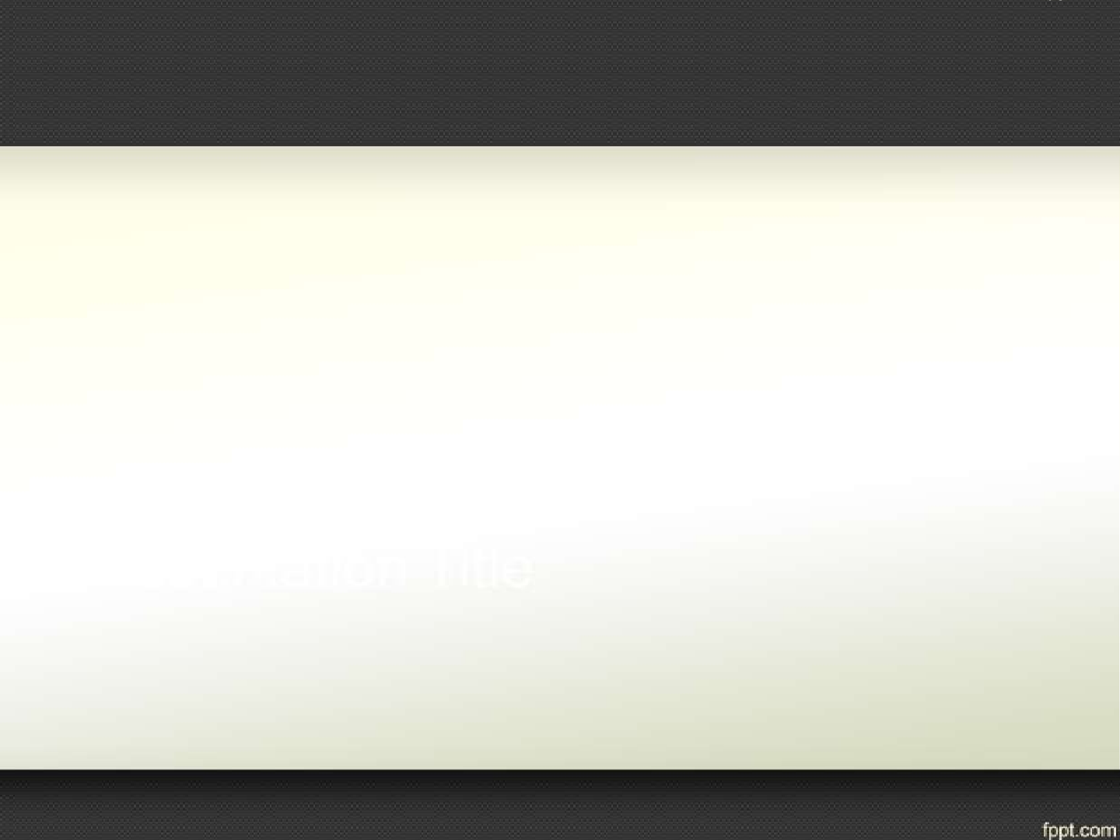
What is an Organizational Structure?
defines the organization's hierarchy of people and departments as well as how information flows within the organization.
It determines:-
how and when information is distributed as well as who makes what decisions based on the information available.
How job tasks are formally divided, grouped and coordinated.

Slide 3

The importance of the Organizational Structure
The Organizational Structure is important because it ensures that there is an efficient operation of a business and it clearly defines its workers and their functions.
The organizational structure also helps define the hierarchy and the chain of command.

Slide 4

The effects of structure on individual and group
The structure of any organisation will affect the
following:-
Behaviour of how people act and work
Motivation of workers
Performance
Teamwork and cooperation
Intergroup and interdepartmental relationships

Slide 5
Organizational Design
Organizational design
– The process by which managers create a specific type of organizational structure and culture so that a company can operate in the most efficient and effective way
10-5

Slide 6

Designing Process
Develop a clear mission statement.
The mission statement should include the inter-relationship between workers at every level.
Decide whether the organization structure will be
centralized and formal or decentralized and informal
The organization structure can be department based or based on a particular project or process.
Design the overall chain of command for the organization.
Add subordinate roles to the chain of command
Determine the authority and responsibility to be assigned to each position in the organization structure

Slide 7

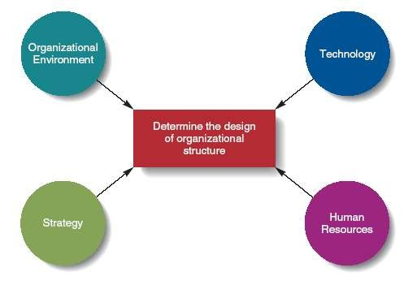
Factors Affecting Organizational Structure
Figure 10.1
10-7

Slide 8
Factors..
The Organizational Environment
The quicker the environment changes, the more problems face managers.
Structure must be more flexible (i.e., decentralized authority) when environmental change is rapid.
10-8

Slide 9

Strategy
Different strategies require the use of different structures.
A differentiation strategy needs a flexible structure, low cost may need a more formal structure.
Increased vertical integration or diversification also requires a more flexible structure.
10-9

Slide 10


Technology
The combination of skills, knowledge, tools, equipment, computers and machines used in the organization.
More complex technology makes it harder for managers to
regulate the organization.
10-10

Slide 11

Technology
Technology can be measured by:
Task variety: the number of new problems a manager encounters.
Task analyzability: the availability of programmed solutions to a manager to solve problems.
10-11

Slide 12
Human Resources
Highly skilled workers whose jobs require working in teams usually need a more flexible structure.
Higher skilled workers (e.g., CPA’s and doctors) often have internalized professional norms and values.
10-12

Slide 13

Human Resources
– Managers must take into account all four factors (environment, strategy, technology and human resources) when designing the structure of the organization.
10-13

Slide 14
The Organizational Environment
The way an organization’s structure works depends on the choices managers make about:
How to group tasks into individual jobs
How to group jobs into functions and divisions
How to allocate authority and coordinate functions and divisions
10-14

Slide 15

Job Design
Job Design
The process by which managers decide how to divide tasks into specific jobs.
The appropriate division of labor results in an effective and efficient workforce.
10-15

Slide 16

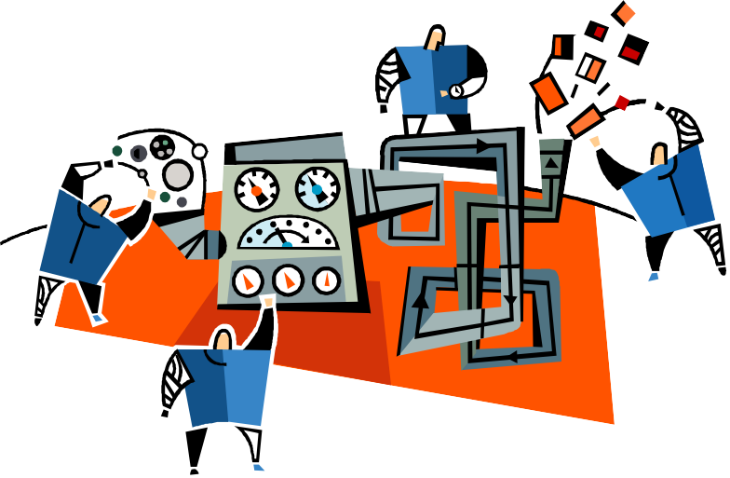
Job Design
Job Simplification
The process of reducing the tasks each worker performs.
Too much simplification and boredom results.
10-16

Slide 17
Job Design
Job Enlargement
Increasing the number of different tasks in a given job by changing the division of labor
Job Enrichment
Increasing the degree of responsibility a worker has over a job
10-17

Slide 18

Job Enrichment
Empowering workers to experiment to find new or better ways of doing the job
Encouraging workers to develop new skills
Allowing workers to decide how to do the work
Allowing workers to monitor and measure their own performance
10-18

Slide 19








TYPES OF STRUCTURES
I. Functional structure – this kind of organisational structure classifies people according to the function they perform in the organization.

Slide 20

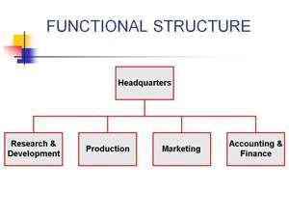

Slide 21
VI. PRODUCT STRUCTURE
Product structure – a product structure is based on organizing employees and work on the basis of the different types of products. If the company produces three different types of products, they will have three different divisions for these products.

Slide 22
V GEOGRAPHIC STRUCTURE
Geographic structure – large organizations have offices at different place, for example there could be a north zone, south zone, west and east zone. The organizational structure would then follow a zonal region structure.

Slide 23
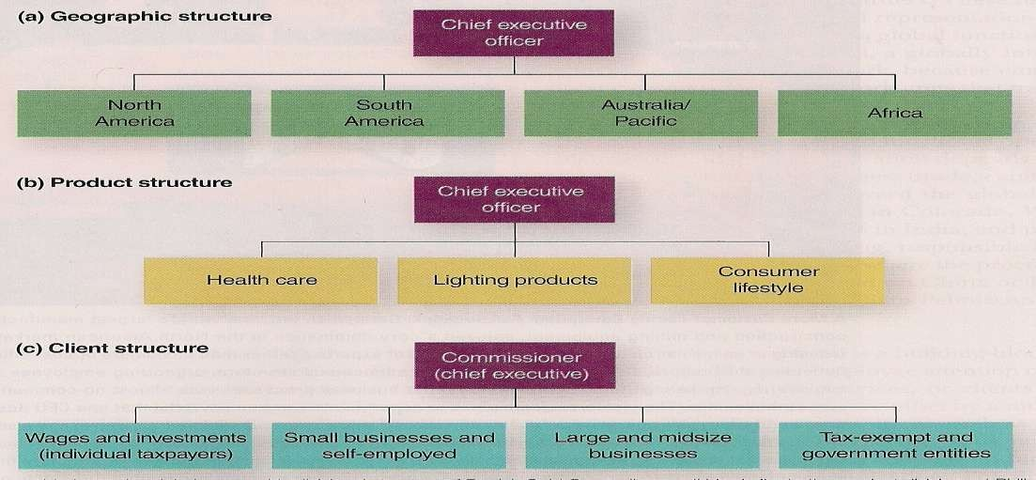

Slide 24

Types cont…
II. Line Structure: This has a very specific line of command. The approvals and orders in this kind of structure come from top to bottom in a line. Hence the name line structure.

Slide 25
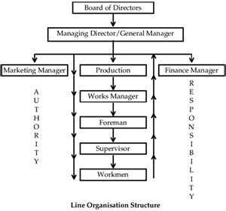

Slide 26
Types cont..
III. Line and Staff Structure: Line and structure combines the line structure where information and approvals come from top to bottom, with staff departments for support and specialization.
The decision making process becomes slower in this type of organizational structure because of the layers and guidelines that are typical to it, and the formality involved.

Slide 27
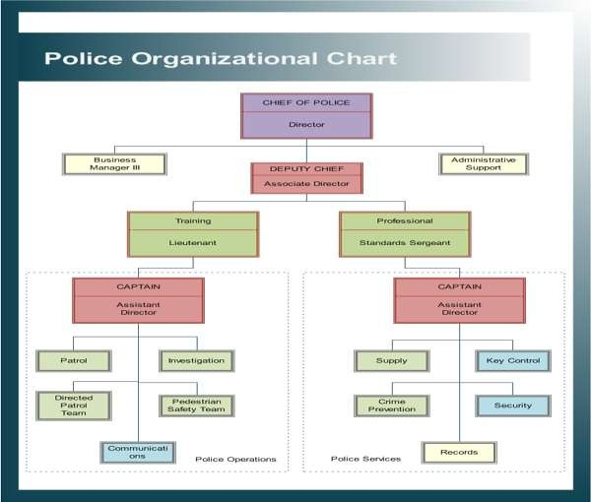

Slide 28
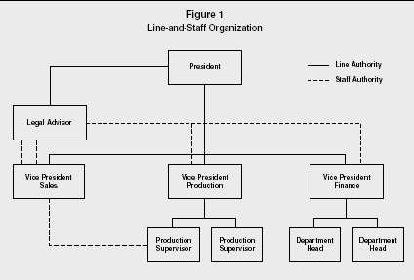

Slide 29
VI. MATRIX STRUCTURES
Matrix Structures
This is a structure, which has a combination of function and product structures. This combines both the best of both worlds to make an efficient organizational structure. This structure is the most complex organizational structure.

Slide 30
Matrix Design Structure
Matrix Structure
An organizational structure that simultaneously groups people and resources by function and product.
Results in a complex network of superior- subordinate reporting relationships.
The structure is very flexible and can respond rapidly to the need for change.
Each employee has two bosses (functional manager and product manager) and possibly cannot satisfy both.
10-30

Slide 31
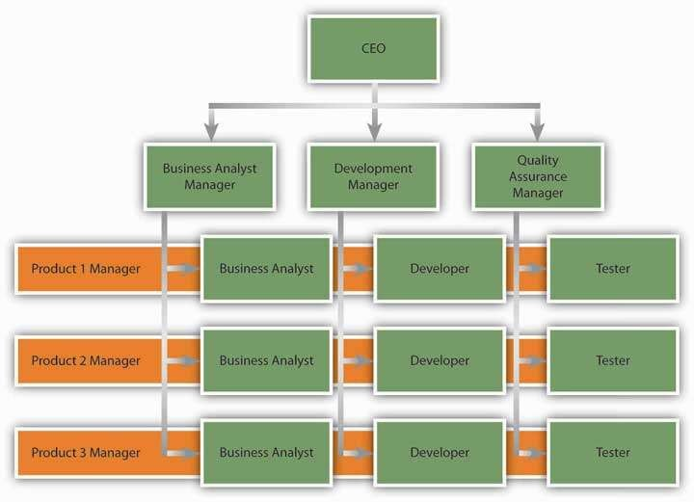

Slide 32
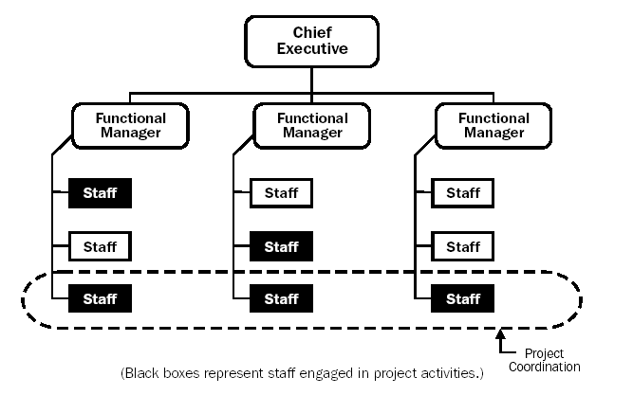
Weak Matrix

Slide 33

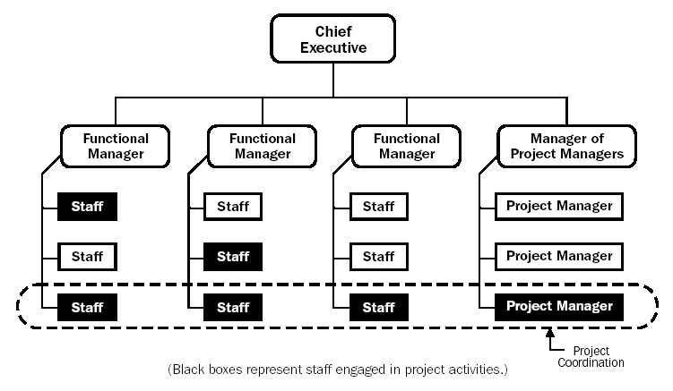
Strong Matrix

Slide 34
Advantages of Matrix Organization
Efficient use of resources
Flexibility in conditions of change and uncertainty
Technical excellence
Freeing top management for long-range planning
Improving motivation and commitment
Providing opportunities for personal development

Slide 35
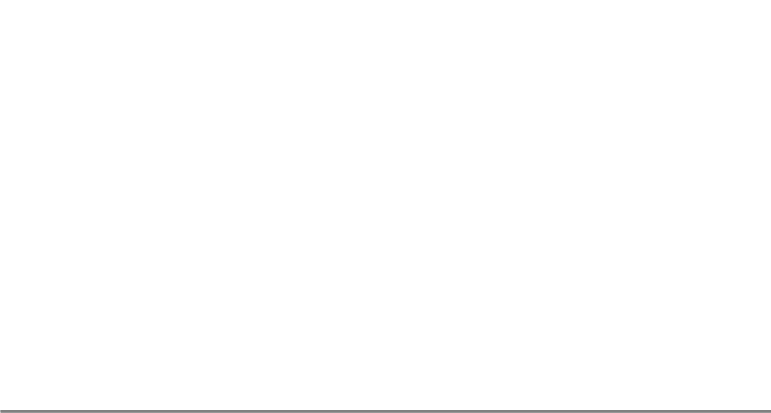











The Four Key Design Decisions
Specialization
Division of Labor:
High
Low
Basis
Departmentalization:
Homogeneous
Heterogeneous
Span of Control:
Number
Few
Many
Authority:
Delegation
High
Low

Slide 36
Division of Labor/specialization
It is a process of identifying the specific jobs that need to be done and designing the people who will perform them.

Slide 37
DIVISION OF LABOUR
Dimension | Division of Labour Low High
Degree of specialization | General tasks | Highly specialized tasks
Typical organizational size | Small | Large
Economic efficiency | Inefficient | Highly efficient

Slide 38
Delegation of Authority
Process of distributing authority downward in an organisation. Whether an organisation chooses to centralize or decentralize will be guided by:
How routine and straightforward are the job’s required decisions?
Are individuals competent to make decisions?
Are individuals motivated to make the decisions?

Slide 39
Delegation of Authority cont..
Reasons to Decentralize Authority:-
It encourages the development of professional managers.
Managers are able to exercise more autonomy but it can lead to a competitive climate.

Slide 40
Delegation of Authority cont…
Reasons to Centralize Authority:-
When the managers are not skilled enough and would need further training which can be expensive.
When there are new administrative costs because new divisions need to be formed.
Decentralization can mean duplication of functions.

Slide 41
Departmental Bases
The process of grouping jobs into logical units.
The process in which an organization is structurally divided by combining jobs in departments according to some shared characteristics.
Functional Departmentalization
Geographical
Product

Slide 42


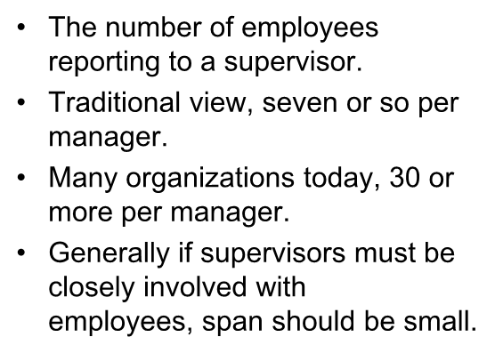


Span of Control
The number of employees reporting to a supervisor.
Traditional view, seven or so per
manager.
Many organizations today, 30 or more per manager.
Generally if supervisors must be
closely involved with
employees, span should be small.

Slide 43
Q & A Session

